Slide 1
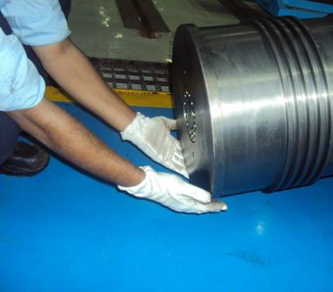
HS&E INCIDENT BULLETIN |  | 2nd Quarter 2012
Type of Incident | Fracture / Laceration
Summary:
Contractor’s workman was assisting D-R Workman during rider ring fitment on piston for clearance and end gap measurement. Piston Rod Assembly was rested on pallet with wooden V block at one end and another end was hanged thru’ crane hook using lifting belt. To have access for ring fitment contractor’s workman tried to move/pull the assembly towards him slightly so that piston edge rest on the pallet. Unfortunately while doing so assembly moved little more and slipped on the floor from the pallet and causing his fingers trapped between floor and two sides of piston (little away from the bottom of piston).
Root Causes: | Actions Taken Thus Far: Next Steps
Workman tried to move the piston assembly thru’ his hands instead of using the crane (unsafe act) Workman failed to recognize risk – placing both hands on ‘line of fire’ (under the load) Lifting belt was not properly tightened on piston. | An appropriate fixture, workbench is to be used for resting the piston assembly while checking/inspection of piston/rider rings. Always use crane for shifting/movement of component and avoid manual movement (push/pull). Lifting belt must be tightened properly on piston assembly for proper hold/grip. JSEA to be prepared for Piston & Rod Assembly and checking clearances and end gaps. Sharing incident and safe/best practice for material handling

